Slide 1
8 bit ALU
Mingiuc Bianca
Mocan Ana-Maria
Jabri Tabrizi Maya
Jurchiță Tiberius-Cristian

Slide 2
Conținut
01
02
03
05
06
07
Datapath și Control ALU
Adunare
Scădere
04
Înmulțire
Împărțire
Unitatea de Control ALU
Implementări

Slide 3
01
Datapath și Control ALU

Slide 4
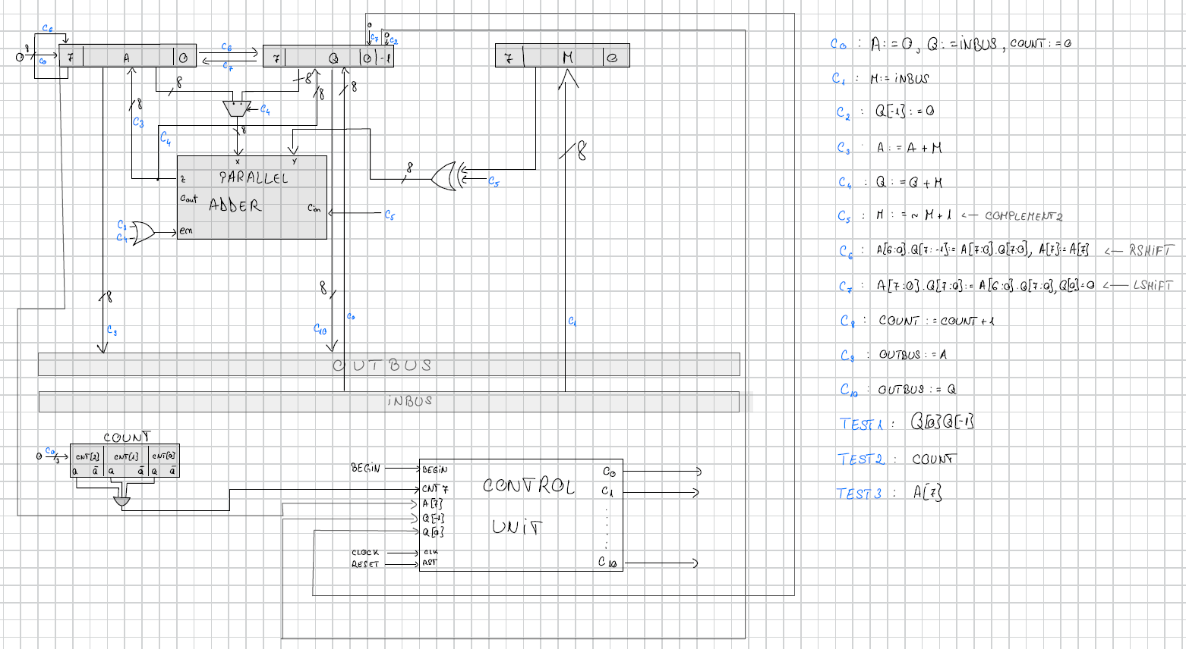
Datapath și Control ALU
Schema
Datapath-ul conține registre, un adder paralel și multiplexoare care gestionează fluxul de date și execută operațiile (add, sub, shift).
Unitatea de control generează semnalele de control (C0–C10) pentru a comanda pașii necesari fiecărei operații, în funcție de codul operației și starea internă.

Slide 5
02
Adunare

Slide 6
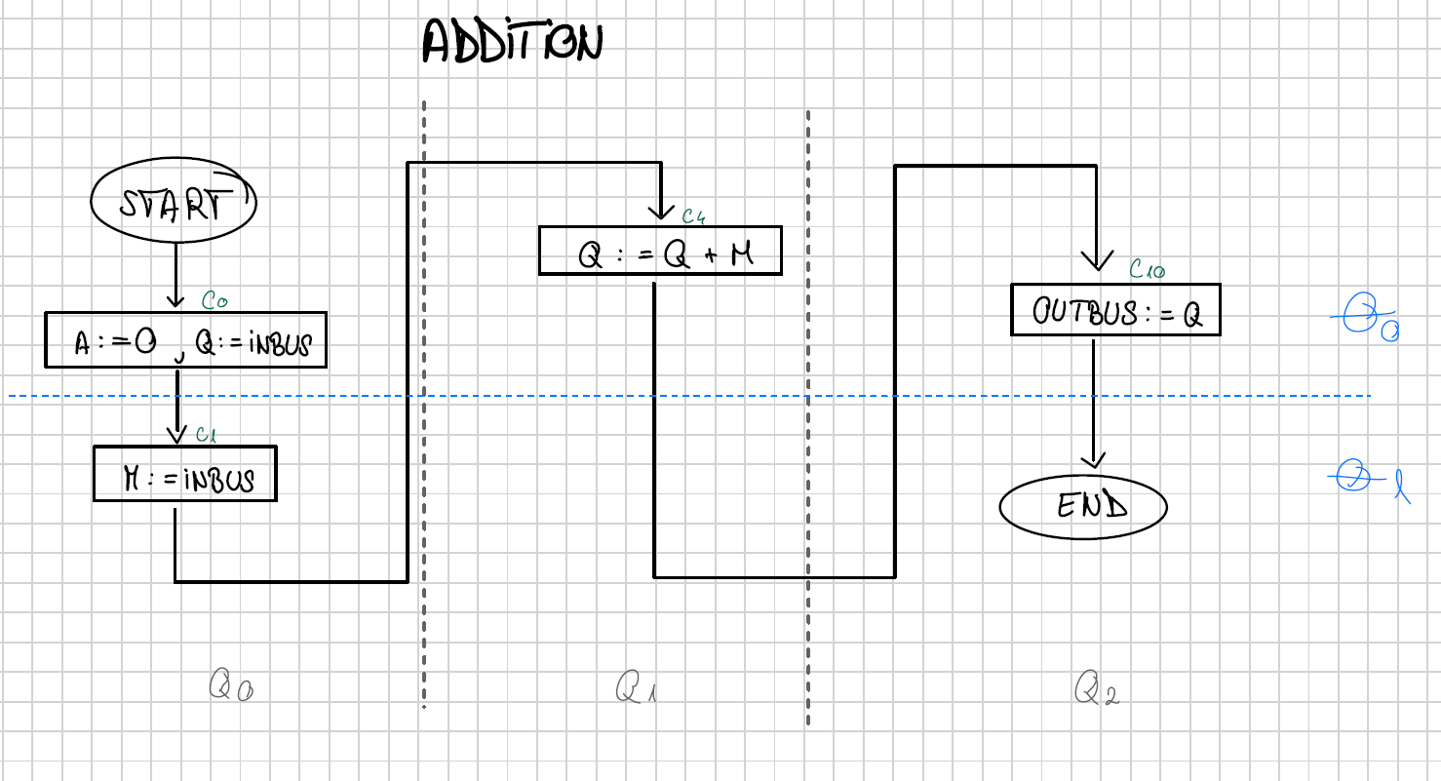
Adunare
Schema

Slide 7
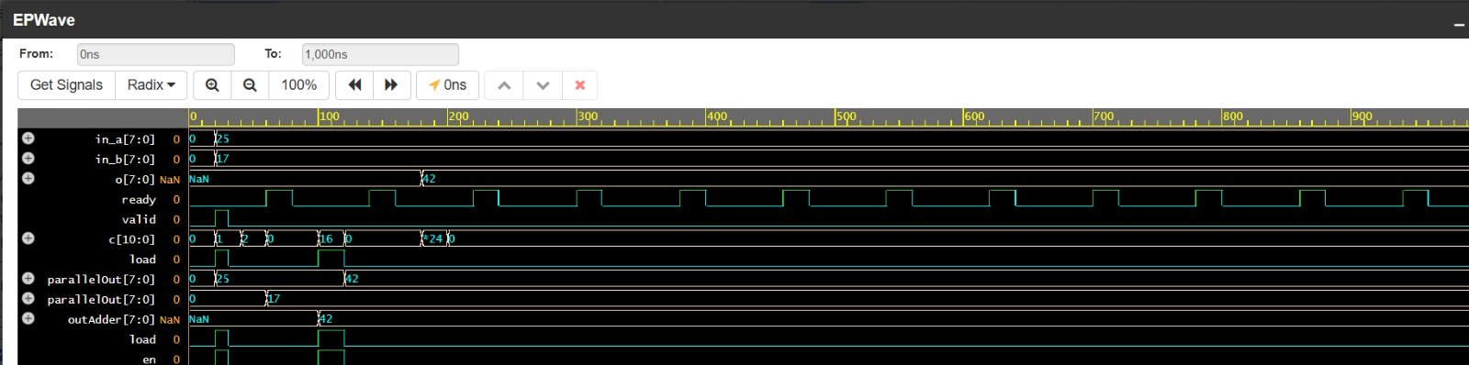
Adunare
Wave

Slide 8
03
Scădere

Slide 9
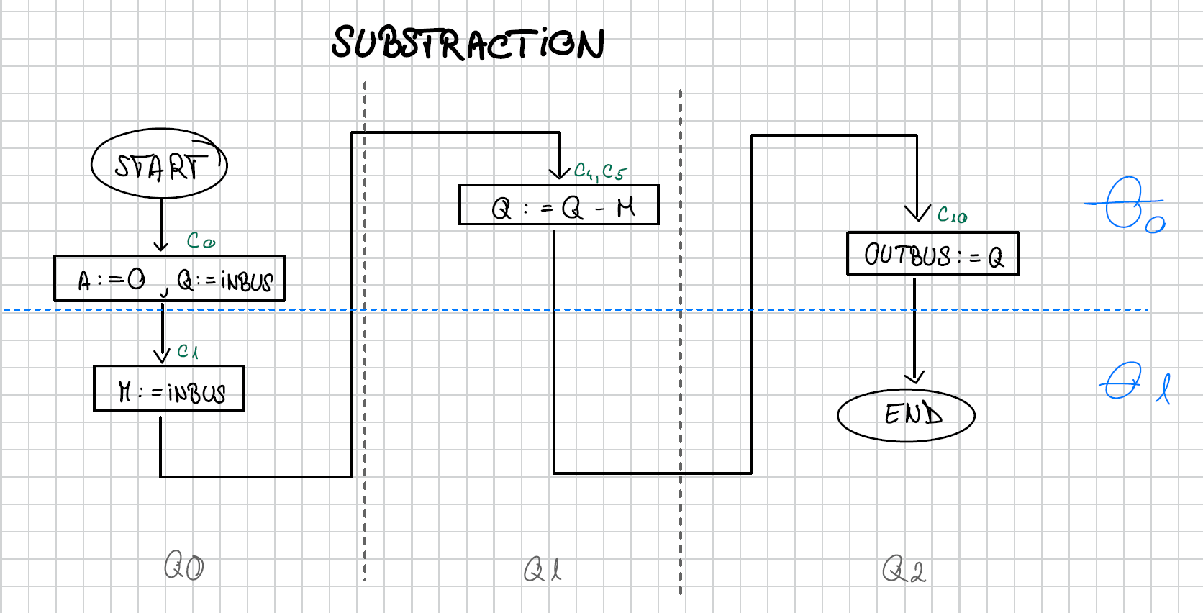
Scădere
Schema

Slide 10
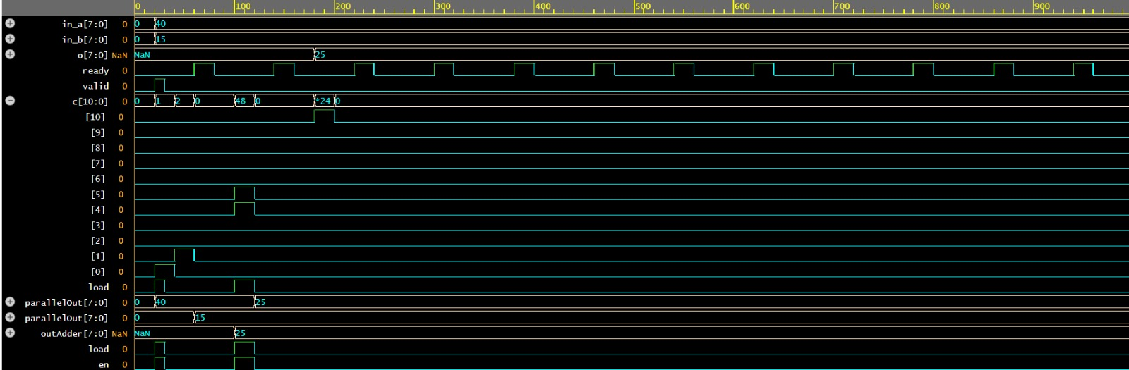
Scădere
Wave

Slide 11
04
Înmulțire

Slide 12
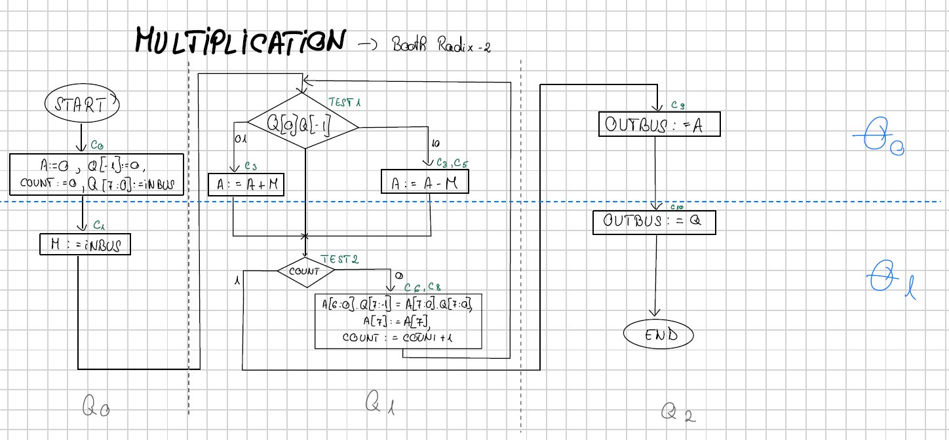
Înmulțire – Booth Radix 2
Schema

Slide 13
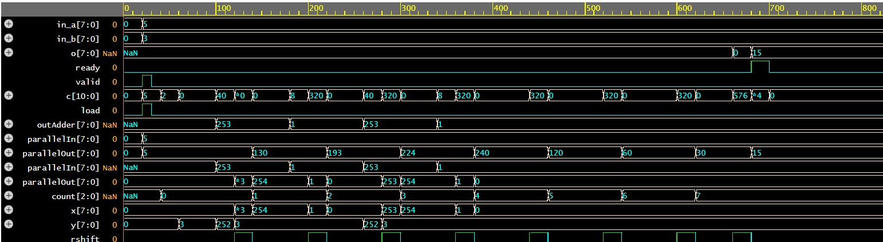
Înmulțire
Wave

Slide 14
05
Împărțire

Slide 15
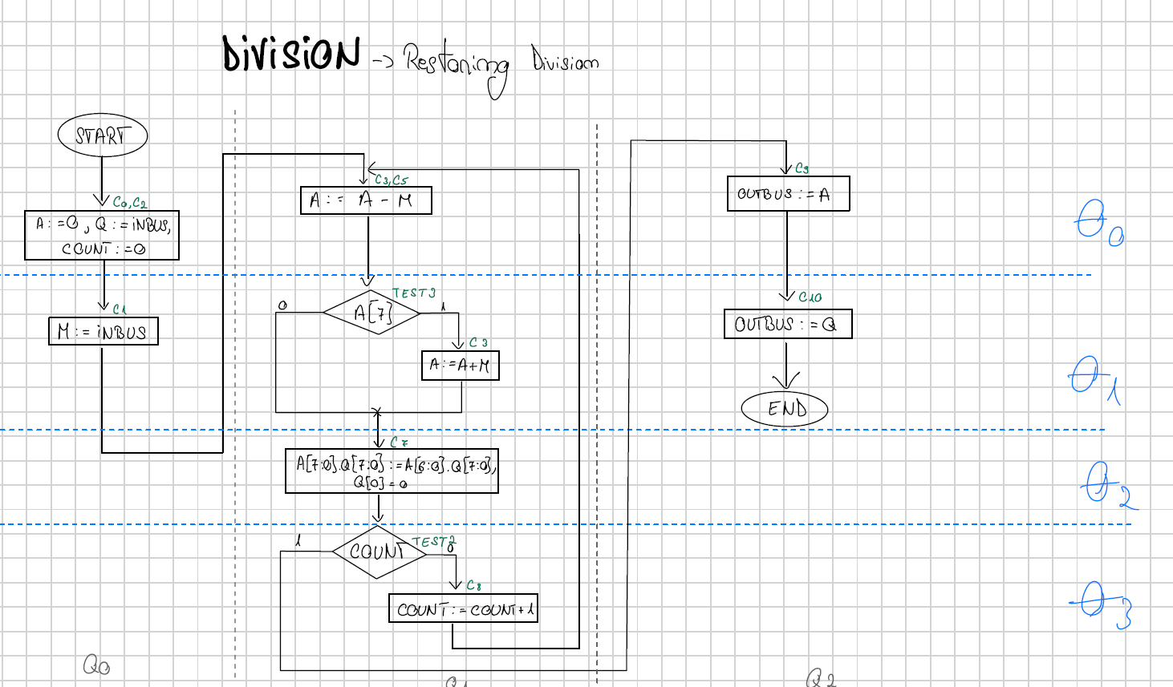
Împărțire – Restoring Division
Schema

Slide 16
Unitatea de Control ALU
06

Slide 17
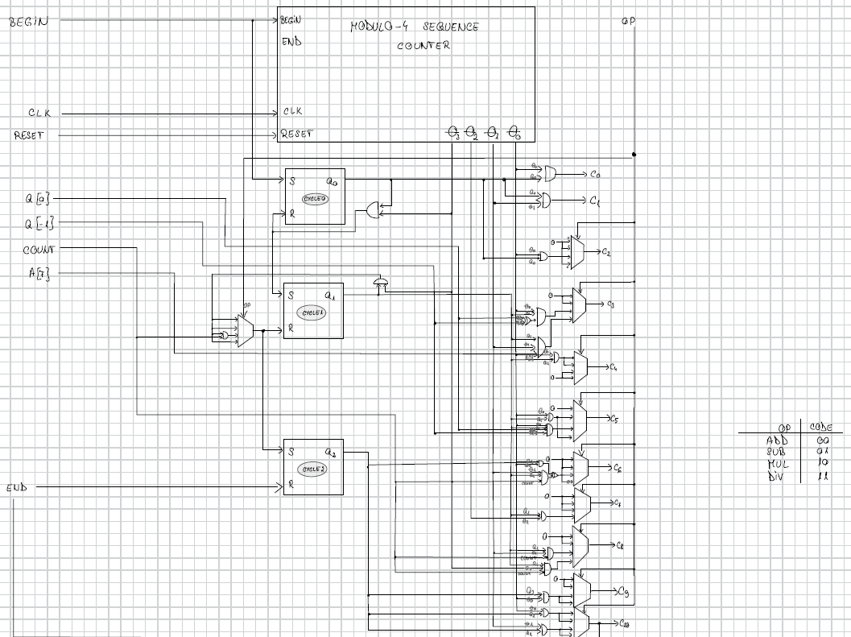
Unitatea de Control ALU
Schema

Slide 18
03
Implementări

Slide 19
ALU
module alu (
input wire [15:0] in,
input wire [1:0] op_codes,
input wire valid,
input wire clk,
input wire rst,
output reg [7:0] o,
output wire ready
);
wire [7:0] in_a, in_b;
assign in_a=in[15:8];
assign in_b=in[7:0];
wire [10:0] c;
wire [7:0] q, m, a;
wire [7:0] outAdder, complementedM;
wire [7:0] muxAdderIn, muxQInput, muxAInput, inputQ;
wire muxQ_1, muxASerialIn, muxQSerialIn;
wire q_1_out;
wire [2:0] count;
wire aSerialOut, qSerialOut;
// Q[-1]
d_ff Q_minus_one_ff (
.clk(clk),
.d(muxQ_1),
.en(c[2] | c[6]),
.rst(rst),
.o(q_1_out)
);
// A register
shift_register reg_A (
.clk(clk),
.rst(rst | c[0]),
.en(c[3] | c[6] | c[7] ),
.load(c[3] ),
.lshift(c[7]),
.rshift(c[6]),
.serialIn(q[0]),
.parallelIn(outAdder),
.serialOut(aSerialOut),
.parallelOut(a)
);
mux2_1_8bit muxsum (.d0(in_a), .d1(outAdder), .sel(c[4]), .y(inputQ));
// Q register
shift_register reg_Q (
.clk(clk),
.rst(rst),
.en(valid | c[4] | c[6]),
.load(valid | c[4]),
.lshift(1'b0),
.rshift(c[6]),
.serialIn(a[0]),
.parallelIn(inputQ),
.serialOut(qSerialOut),
.

Slide 20
ALU
parallelOut(q)
);
// M register
shift_register reg_M (
.clk(clk),
.rst(rst),
.en(c[1]),
.load(c[1]),
.lshift(1'b0),
.rshift(1'b0),
.serialIn(1'b0),
.parallelIn(in_b),
.serialOut(),
.parallelOut(m)
);
// Complement M
complement complementM(
.in(m),
.en(c[5]),
.out(complementedM)
);
// Muxes
mux2_1_8bit mux_adder_in (
.d0(a), .d1(q), .sel(c[4]), .y(muxAdderIn)
);
mux2_1_8bit mux_q_input (
.d0(in),
.d1(outAdder),
.sel(c[4]),
.y(muxQInput)
);
mux2_1_8bit mux_a_input (
.d0(8'd0),
.d1(outAdder),
.sel(c[3]),
.y(muxAInput)
);
mux2_1_1bit mux_q_minus_one (
.d0(1'b0),
.d1(qSerialOut),
.sel(c[6]),
.y(muxQ_1)
);
mux2_1_1bit mux_serial_a (
.d0(a[7]),
.d1(qSerialOut),
.sel(c[7]),
.y(muxASerialIn)
);
mux2_1_1bit mux_serial_q (
.d0(1'b0),
.d1(aSerialOut),
.sel(c[6]),
.y(muxQSerialIn)
);
// Parallel Adder
adder ALU_Adder (
.x(muxAdderIn),
.y(complementedM),
.ci(c[5]),
.en(c[3]|c[4]),
.o(outAdder)
);
// Counter
counter Count (
.clk(clk),
.rst(c[0]),
.en(c[8]),
.o(count)
);

Slide 21
ALU
// Control Unit
control_unit Control (
.clk(clk),
.reset(rst),
.start(valid),
.Q0(q[0]),
.Q_1(q_1_out),
.A7(a[7]),
.count((count[0]&count[1]&count[2])),
.opcode(op_codes),
.control(c),
.done(ready)
);
// Output
always @(*) begin
if (c[10])
o = q;
else if(c[9])
o = a;
end
endmodule

Slide 22
Control Unit
module control_unit (
input wire clk,
input wire reset,
input wire start,
input wire [1:0] opcode,
input wire Q0,
input wire Q_1,
input wire A7,
input wire count,
output wire [10:0] control,
output wire done
);
wire [3:0] state;
mod4_counter sequence_counter (
.clk(clk),
.reset(reset),
.begin_op(start),
.state(state)
);
wire theta0, theta1, theta2, theta3;
assign theta0 = state[0];
assign theta1 = state[1];
assign theta2 = state[2];
assign theta3 = state[3];
wire q0, q1, q2;
wire setter;
sr_ff ff_q0 (.clk(clk), .rst(reset), .S(start), .R(theta3&q0), .Q(q0));
mux4_1_1bit mux_sr (.d0(theta3&q1), .d1(theta3&q1) , .d2((theta3&q1)&count), .d3(theta3&q1), .sel(opcode), .y(setter));
sr_ff ff_q1 (.clk(clk), .rst(reset), .S(theta3&q0), .R(setter), .Q(q1));
sr_ff ff_q2 (.clk(clk), .rst(reset), .S(setter), .R(done), .Q(q2));
// Control signals
wire C0, C1, C2, C3, C4, C5, C6, C7, C8, C9, C10;

Slide 23
Control Unit
assign C0=theta0&q0;
assign C1=theta1&q0;
mux4_1_1bit mux_C2 (.d0(1'b0), .d1(1'b0), .d2(theta0&q0), .d3(1'b0), .sel(opcode), .y(C2));
mux4_1_1bit mux_C3 (.d0(1'b0), .d1(1'b0), .d2(theta0&q1&(((~Q0)&Q_1)|(Q0&(~Q_1)))), .d3(theta1&q1&A7), .sel(opcode), .y(C3));
mux4_1_1bit mux_C4 (.d0(q1&theta0), .d1(theta0&q1), .d2(1'b0), .d3(1'b0), .sel(opcode), .y(C4));
mux4_1_1bit mux_C5 (.d0(1'b0), .d1(theta0&q1), .d2(theta0&q1&Q0&(~Q_1)), .d3(theta0&q1), .sel(opcode), .y(C5));
mux4_1_1bit mux_C6 (.d0(1'b0), .d1(1'b0), .d2(((~count)&q1&theta1)|(q2&theta0)), .d3(1'b0), .sel(opcode), .y(C6));
mux4_1_1bit mux_C7 (.d0(1'b0), .d1(1'b0), .d2(1'b0), .d3(q1&theta2), .sel(opcode), .y(C7));
mux4_1_1bit mux_C8 (.d0(1'b0), .d1(1'b0), .d2((~count)&q1&theta1), .d3(q1&theta3&(~count)), .sel(opcode), .y(C8));
mux4_1_1bit mux_C9 (.d0(1'b0), .d1(1'b0), .d2(theta0&q2), .d3(theta0&q2), .sel(opcode), .y(C9));
mux4_1_1bit mux_C10(.d0(theta0&q2), .d1(theta0&q2), .d2(theta1&q2), .d3(theta1&q2), .sel(opcode), .y(C10));
assign control = {C10, C9, C8, C7, C6, C5, C4, C3, C2, C1, C0};
assign done = C10;
endmodule

